Slide 1
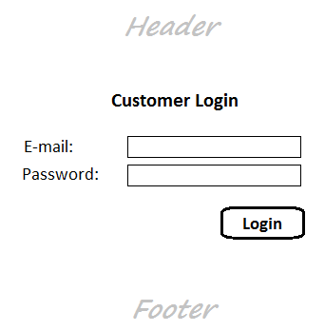
Implement Authentication for Customer

Slide 2
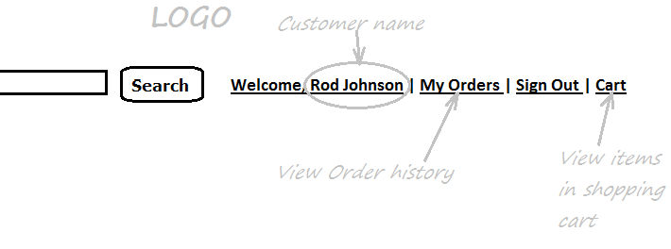
Customer’s Menu

Slide 3
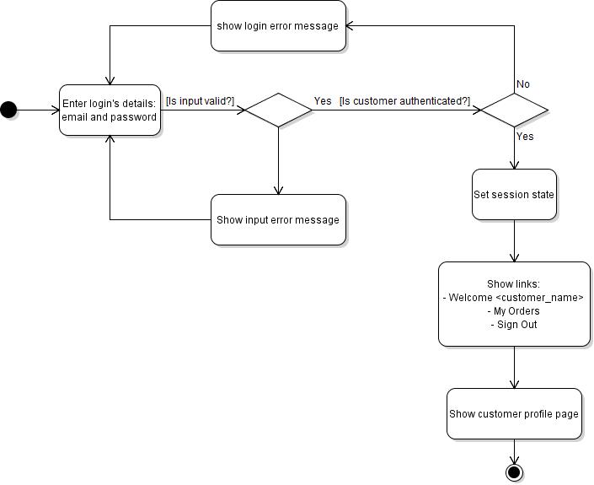
Activity Diagram: Customer Login

Slide 4
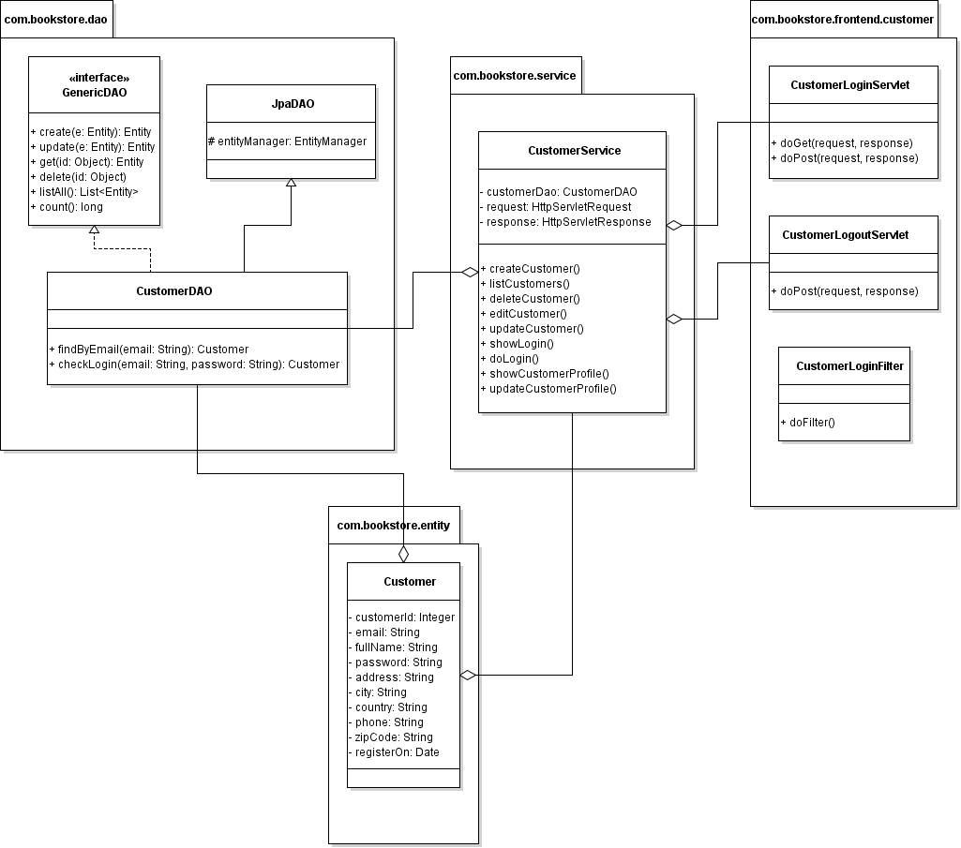
Class Diagram

Slide 5
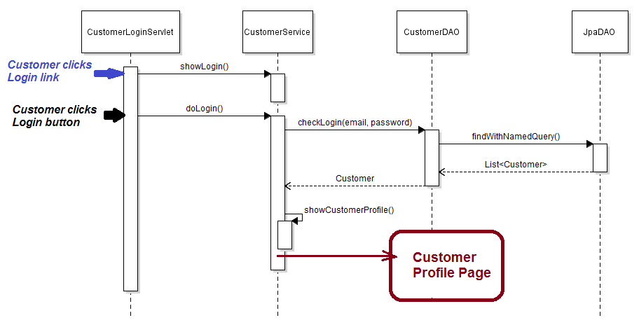
Sequence Diagram: Customer Login

Slide 6
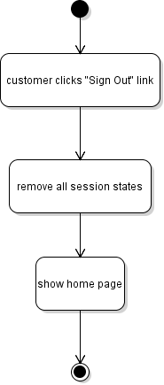
Activity Diagram: Customer Logout

Slide 7
Similarly we can follow the same technique:
Code Customer Login Form
Code CustomerLoginServlet
Code CustomerLogoutServlet
Code CustomerLoginFilter

